Slide 1

Android Auto
09.10.2017
Notes:
Good morning, thank you all for you presence, my name is João Ramos and this is Mauro Pires, and we are going to make a presentation about Android Auto

Slide 2
Agenda
1
Overview - Android Auto
2
How it works?
3
Building Apps for Auto
4
Compatible with Android Auto
5
Embedded Android for Automotive
Notes:
We divide the presentation in 5 sections, in the first we will give you an overview about Android Auto, after that we are going to explain how it works. In the third section we are going to explain how to build an app for Auto and some resterictions associated in the building process. In the forth section we will present some car and aftermarket displays, that have already implemented Android Auto, and also some countries which the application is available. Finally we are going to talk about Embedded Android Auto, which was presented in google I/O 2017

Slide 3
1.
Overview- Android Auto

Slide 4
Overview- Android Auto
Release Date: March 19, 2015
Android Application for smartphone that allows a connection with the car using a USB cable
Android Auto connects via Bluetooth, in order to connect with the car sound system
Simpler is safest
Only brings useful information
Organized into simple cards
Apps need to have consistent design
Large and round buttons, for easy touch points
Similar menu structures
Notes:
Android Auto Is an app designed to help the driver so he cannot be distracted by the phone
It works by projecting Android apps onto the in-car display after the phone has been plugged in to the car via USB
Phone calls are going to be handled over Bluetooth
Useful information such as text messages, a coming call.
Simple cards which presents all the relevant information, in a intuive way.
Android Auto apps have a consistent design, with large, round buttons for easy touch points, and similar menu structures. The idea is that apps won't be any more distracting than they need to be (which is why user interface elements look the same from one app to another), and generally don't need more than a quick glance to be put to work.

Slide 5
Comparison with Competitor Technologies
GPS Navigation
Google maps is the more precise and user friendly application for GPS Navigation
Voice Control
Speech recognition from Google is more refined, and his able to interpret more commands
Not compatible car
Android Auto has the ability to work in the phone
Notes:
The biggest advantage to use Android Auto instead of the implemented IVI (in vehicle infotainment) of a brand, is that using android Auto we get updates from google, one the other hand in a implemented IVI, once is done is done, we need to go to the brand in order to update the system.
We know there are people who prefer using other apps for GPS Navigation, but in most of the videos and reviews we saw, they say that Google Maps is the best for being more precise and user friendly, than the others
We saw the comparison between voice control system between google and Apple, and the google voice control performs better, in the interpretation of what a person wants to say.
We also don’t need to buy a new car or spend 700€ in a aftermarket stereo, we can simply use our phone to do the work.

Slide 6
2.
How it works?

Slide 7
How it works?
If connected to the car the phone stays unusable
There are 5 panels available, if connected with the car dash screen
If we use the phone there are 4 panels available
Home menu has information such as the weather, current song, current destination and upcoming appointments
Only important information appear while driving
Notifications such as alerts from Email, Facebook or Twitter, will not show in the notifications log
Notes:
Need to be android 5.0 plus
5 panels -> navigation, phone log, home, media, car diagnosis
Home menu is organized in order to show some info like the weather current song, current destination and upcoming appoitments
Important information, like a message received, from whatsupp, facebook messeger or hangouts
A phone call incoming

Slide 8
Voice Command
To start Voice Command we can use:
At the beginning of the sentence we say “OK Google”
By a button placed in the top right corner
Press the talk button presented in steering wheel
Using Voice Command we can:
Set the destination place
Call a person
Initialize a song
Access to any menu
Notes:
Like said before, the car sound system is connected via bluethoot.
We have a lot of options to start a voice command, for example if we use the “OK Google”, we don’t need to touch the screen, and keep the eyes on the road at the same time we are doing something else.
A example to set the destination we can say “OK Google, set directions to …” and we say the address.
We can also ask for a specific song in a specific app
Basically, We can use every OK Google command available for android system

Slide 9
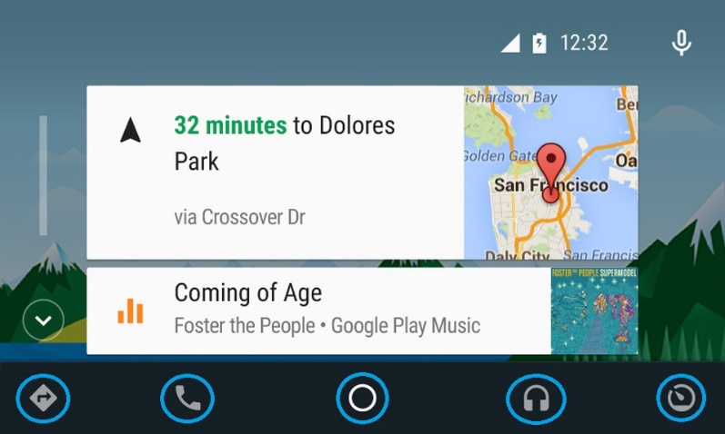
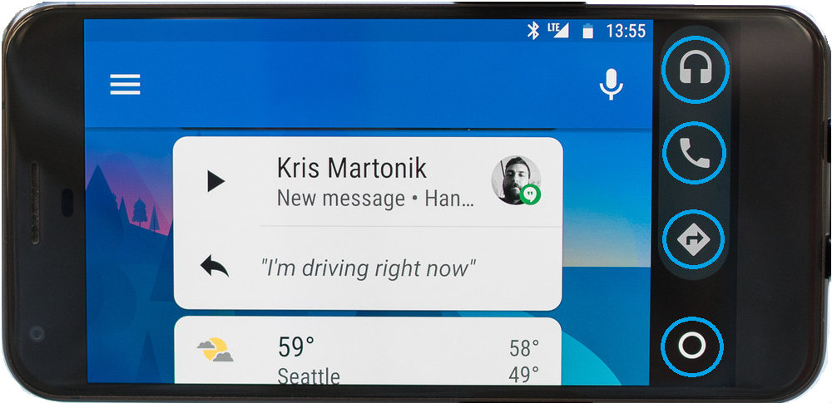
Android Auto - Panels
On phone Screen
On Car Dash Screen
Notes:
Here is shown the phone screen and the car dash screen, and the blue markers show the panel with 5 or 4 buttons
For car diagnosis the app called Torque is the one that is used

Slide 10
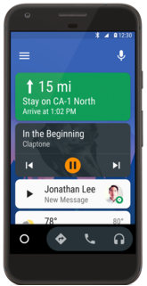
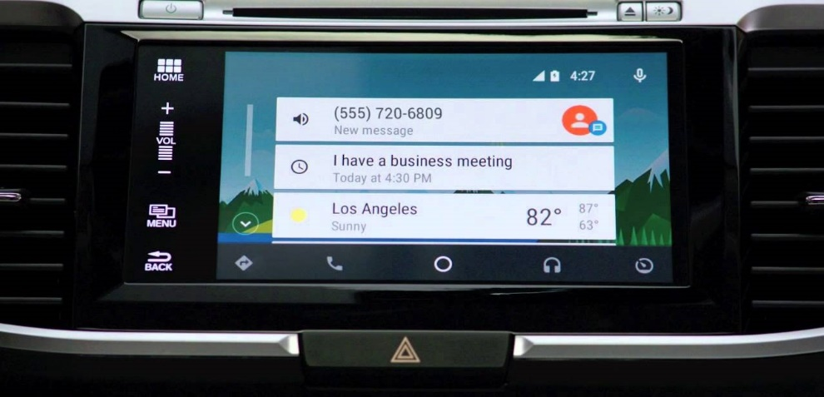
Android Auto - Home Menu
On phone Screen
On Car Dash Screen
Notes:
Here is shown some examples of the home menu, where we see the relevant information, in the case of the phone we see the current destination, the actual music and a received message, in the car dash is shown a received message, a coming appointment and the current wheather

Slide 11
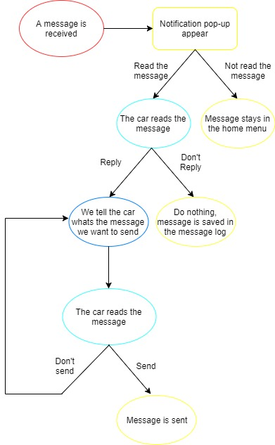
When a message is received

Slide 12
3.
Building Apps for Auto

Slide 13
Set up an Auto project
Auto supports two types of apps
Audio apps - allow users to browse and play music and spoken audio
Messaging apps - receive incoming notifications, read message via text-to-speech, and send replies via voice input
Prerequisites
Create or update your app project - target Android 5.0 (API level 21) or higher
Install the support library- NotificationCompat.CarExtender class allows you to create notifications that are compatible with Auto devices
Declare Auto capabilities
Define the Auto XML configuration- Specify the car capabilities that your app uses in an XML file
Add a manifest entry - provide a reference to the Auto XML configuration file you created
Add Auto features to your apps
Notes:
Android Auto extends a new or existing application
Developers don’t need to worry about vehicle specific hardware differences
Android must be 5.0 or higher

Slide 14
Providing Audio Playback for Auto
Build a Browser Service
Media browser service extends MediaBrowserService class
Android Auto includes a browsing capability that lets users select a letter from an on-screen keyboard
Building content hierarchy
Enable Playback Control
Register a media session - set a callback object that is used to handle playback control requests
Implement play commands - your app must extend the abstract MediaSession.Callback class and implement the methods that your app supports
Support Voice Actions
Enable your audio app to launch with a voice command - "Play [search query] on [your app name]"
Parse the voice query to build the playback queue
Playback control actions - implement the callback methods with the playback controls that you support in your app.
Notes:
Configure your application with this settings and implement a service for accessing music. This enables Android Auto to discover your app and provide a browse and playback interface for your application

Slide 15
Providing Messaging for Auto
Define read and reply intent filters
Define the read action and reply action intent types for your app and the BroadcastReceiver classes
Import Support Library for Messaging
Update the support libraries, building notifications requires classes from the v4 support library
Notify Users of Messages
Create conversation read and reply intents - create a PendingIntent object for each of these actions
Set up the conversation builder - Auto organize messages into conversations
Handle User Actions
Handling a message read action - Auto sends a read intent based on how your app defined the messaging notification
Handling a reply action - Auto sends a read intent based on how your app defined the messaging notification
Notes:
For application that support messaging you need to extend their messaging notification to allow Android Auto to display them and for users to read and responde to them.
With a consistent and low distraction ( Google Assistant)

Slide 16
Testing Apps for Auto
Android Auto is available for both car and phone screens
Car screen - Desktop Head Unit (DHU), a testing tool for Auto apps that lets you test pre-released versions of your Android Auto apps
Phone screen - This option lets you display and test pre-released versions of your app on Android Auto for the phone screen
Car screen
DHU enables your development machine to emulate an Android Auto head unit
The DHU runs on Windows, Mac, and Linux hosts
After you’ve installed the DHU, you can test your Android Auto apps by connecting your phone and workstation via USB
Phone screen
Install the Android Auto app, available on Google Play, on your handheld and enable unknown sources in developer mode
Enable USB debugging
Install your app onto the handheld and test
Notes:
Testing apps is important for ensuring that the user doesn’t encounter unexpected results or a poor User Experience
There 2 ways of testing:
DHU –> software that emulates a Car Head Unit

Slide 17
Auto App Quality
Need to meet all relevant core app quality criteria for the Android platform
Core app quality
Visual Design
Driver attention
Layout
Visual Contrast
Interaction
Auto app quality
General
Media
Notifications
Messaging
Functionality
Notes:
When designing support for Android Auto in your app the main goal is to avoid driver distraction, apps should use a simple visual design and use voice commands.
Apps should be predictable and use simple patterns for common tasks.
Core app quality – in addiction to Auto specific criteria , Android Auto apps should meet all the relevant core app quality criteria for the Android platform
Visual design – these criteria ensure that your app follows a design and interaction patterns that offer a consistent and intuitive user experience.
Functionality - These criteria ensures that your app is configured and provides the expected functional behaviour

Slide 18
Distribute to Android Auto
Understand the guidelines and requirements - read and understand the quality guidelines for Auto apps
Develop a app for Auto - Android Auto is a part of a new or existing app for Android devices, using the same package name and store listing
Test for Auto app quality - Apps should be designed to perform well, look great in the car, and offer the best user experience possible
Agree to Android Auto terms and publish - Google Play submits your app for review against the Auto app quality criteria and notifies you of the result
Track your review
App will be reviewed for compliance with driver distraction guidelines and the technical and quality criteria
After a successful review, your app will be published and made available on the Google Play Store
Notes:
Review – Detailed review process may take more time than a normal app
If your app is not accepted, you will receive an email with a list of areas you need to address, after the necessary adjustments you can put your newer version to review

Slide 19
4.
Compatible with Android Auto

Slide 20
Compatible with Android Auto
There are 38 brands of cars that have already implemented Android Auto in some models, such as: Audi, Chevrolet, Lamborghini and Volvo
In the near future the Android Auto will be implemented in 14 more brands
Android Auto is also implemented in 5 brands of aftermarket displays, such as: Kenwood, Panasonic and Sony
In the near future Android Auto will be implemented in 4 more brands of aftermarket displays
Android Auto is only available in 31 countries
In Portugal, there isn’t a official release date yet, however the APK can be downloaded, and some functionalities can be used.
Notes:
Examples of countries: Germany France USA

Slide 21
5.
Embedded Android for Automotive
Notes:
They implemented the Android source code by reconfiguring it into a car OS, without involving Google
This attempt, unfortunately, has failed because by the time the product reached the market (after a long development process), the version of Android launched was older and it cannot be updated
Though the anticipation that Google will produce a Play Store for the car OS is still not been confirmed. But the latest OS promises the control for Heating, ventilation and air conditioning (HVAC) unit and radio as well.

Slide 22
Overview – Embedded Android for Automotive
Release Date: No official release date, shown in May 17, 2017 in Google I/O
Android-based operating system designed for vehicles
Tightly-integrated with the features of the car
Can control various sensors and switches
Gives the car OEMs more control over the UI
Full customization is important for adoption
Notes:
Embedded Android for Automotive is an Android based operating system designed to run on vehicles
With Googles help, car manufactures will ship a newer version of android
The cars shown with this system were running Android 7 with the plan to be upgraded to the next Android version once it becomes final

Slide 23
How it works?
Similar to Android Auto
UI elements and built-in apps differ from OEM to OEM
Expect implementations from different automakers to look and feel unique
Different design elements
Different display types
Notes:
Google produces the core software , OEMs rebrand the interface with their own UI
Google also provides apps like Google Maps and Google Music, and OEMs are free to add their own apps
For example Audi has its own navigation system in addition to Google Maps.

Slide 24
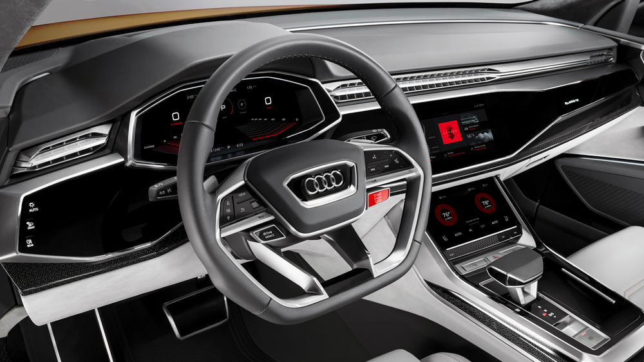
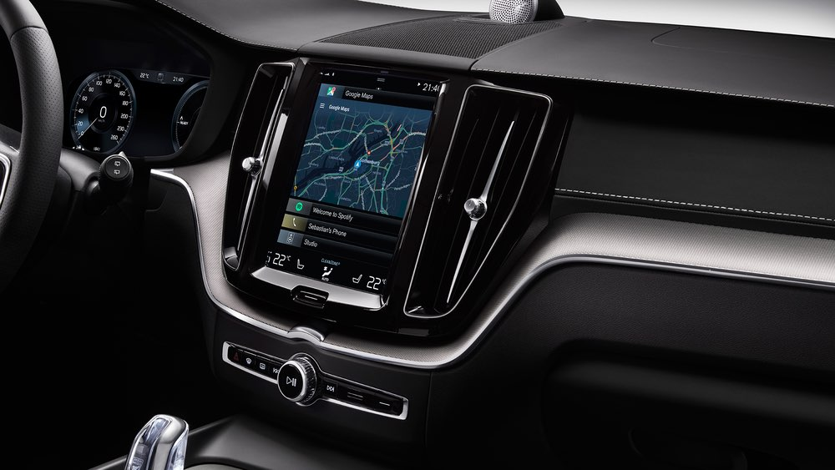
Car Models where it is available (Google I/O 2017)
Audi Q8
Volvo V90 SUVs
Notes:
As you can see the user interface is very different from the Android Auto UI.
Audi and Volvo can keep a design and layout that are familiar with their costumers

